Slide 1
Pitfalls and Pearls- Guidance for Writing a Strong Duke AHEAD Grant Proposal
Midge Bowers DNP, FNP-BC
Rebecca Sadun MD PhD
Megan von Isenburg MSLS

Slide 2
Objectives
By the end of this session, participants will be able to:
Explain the rules that govern budget development for Duke AHEAD grants.
Identify common weaknesses in education grants.
Describe ways to strengthen an education grant application, with a focus on the grant’s aims and assessment strategies.

Slide 3
Prioritize projects focused on the following:
Innovative educational strategies and practices that
apply adult learning theory
Social justice
Climate change and health
Community connections
Creating a supportive, healthy learning environment
Notes:
Proposals will be evaluated for alignment with the mission and goals of Duke AHEAD and for these criteria, recognizing that not all will be relevant to a given proposal:
Don’t have to focus just on these topics

Slide 4
Mission of Duke AHEAD
Our mission is to promote excellence in the education of health professionals by creating a community of education scholars, fostering innovation in health professions education, supporting outstanding teachers, providing faculty development programs and facilitating quality education research.

Slide 5
Innovation Grant Criteria
Organization and quality of proposal
Importance of outcomes
The Why?
Learner assessment, program evaluation
Potential impact:
Including collateral benefits beyond project participants
Notes:
Innovation and how do you demonstrate

Slide 6
Innovation Grant Criteria
Rigor of assessment plan
Dissemination plan
Potential sustainability of project
Potential for scholarship
Notes:
Proposals will be evaluated for alignment with the mission and goals of Duke AHEAD and for these criteria, recognizing that not all will be relevant to a given proposal:
Collaboration- working with biostats
Moving beyond satisfaction surveys- work with duke learning innovation and lifetime education

Slide 7
Budget Rules
Request for funds should be meaningful and relevant to the project.
Projects will be funded at two levels: up to $5,000 or up to $10,000.
Support will be limited to resources and services necessary for project implementation.
Up to 25% of the total budget to allow for PI support if necessary.
The grant review committee reserves the right to offer partial awards and/or redistribute funds based on the number of proposals awarded and the relevance of budgeted items.
Notes:
Multiple projects will be funded.

Slide 8
Grant Application Example 1
Title: Optimizing the Rheumatology Elective for Residents
Focused question: Can improving access to rheumatology electives increase the number of practicing rheumatologists?
Specific Aims:
Aim 1 – Refine elective learning objectives
Aim 2 – Create vignettes for rotating residents
Aim 3 – Assess what residents learn on their rotation

Slide 9
Budget
 |  | Estimated Cost
PI support |  | $2,000.00
Consultant Costs | Learning specialist from UNC | $1,000.00
Equipment |  | $0.00
Computer | Hardware – New projector | $1,800.00
 | Software | $0.00
Supplies |  | $0.00
Travel | (1,000/trip) | $0.00
Other Expenses | Copies of seminal articles and textbooks for learners | $2,000.00
Total Costs for Proposed Project |  | $6,800.00
Specific Aims
Aim 1 – Refine learning objectives
Aim 2 – Create vignettes for rotating learnings
Aim 3 – Assess what trainees learn on their rotation

Slide 10
Weaknesses
No clear education innovation; no synergistic collaborations
This is work that should be supported by the division
More than 25% of the budget goes to the PI’s salary (against the rules)
A large portion of the salary is for capitol expenses minimally related to this project (e.g., projector, textbooks)
Misalignment with question (assessment doesn’t seek to measure impact of the curriculum on # primary question)
Outcome unlikely to be publishable (doesn’t contribute to the field)
Will not advance the PI’s career (or lead to future grant opportunities)
Unclear how many learners will benefit (low impact)

Slide 11
IMPROVED Grant Application Example 1
Title: Teaching Core Principles of Palliative Care to Rheumatologists
Focused question: Can rheumatologists learn core palliative care skills and appropriately to refer to palliative care for complex cases?

Slide 12
Old Specific Aims:
Aim 1 – Refine learning objectives
Aim 2 – Create vignettes
Aim 3 – Assess what residents learn
New Specific Aims:
Highlight innovation
Clarify outcomes
Demonstrate impact
Specific Aims
Aim 1 – Conduct a survey of 40 rheumatology providers (MDs and APPs from 2 institutions) to assess baseline knowledge/confidence/practice:
baseline knowledge of symptom management techniques
baseline confidence in initiating goals of care conversations
baseline estimated frequency of placing palliative care referrals
Aim 2 – Offer a three-part curriculum to 40 rheumatology providers:
teach the basic principles of fatigue management
train on how to start a goals of care conversation
convey the role of outpatient palliative care consultative services
Aim 3 – Assess the impact of the above curriculum using a post-survey (knowledge & confidence) and case vignettes (skills & attitudes)

Slide 13
Budget
 |  | Estimated Cost
PI support |  | $2,500.00
Consultant Costs | Biostatistician REDCap Build | $3,500.00 $1,000.00 | Amount based on quote from statistical core Amount based on prior build costs
Equipment |  | $0.00
Computer | Hardware | $0.00
 | Software | $0.00
Supplies |  | $0.00
Travel | ACR 2026 | $1,000.00 | Will present at rheumatology national mtg
Other Expenses | Publication fee | $2,000.00 | Plan to publish in AC&R
Total Costs for Proposed Project |  | $10,000.00

Slide 14
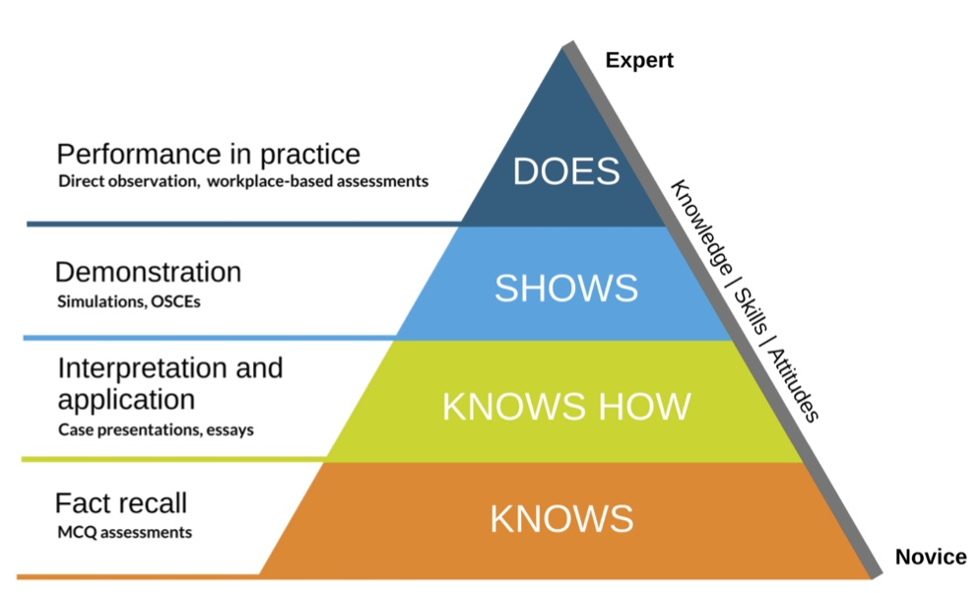
Learner Assessment

Slide 15
Example 2: Service Learning Proposal
Version A
Strengths
Version B
Compare
Lessons Learned
Apply to your proposals
Weaknesses

Slide 16
A
Title: Teaching Diabetes in Durham
Focused question: Can a medical student service learning project reduce the burden of diabetes in Durham?
Background: (including brief review of prior research)
Diabetes is a widespread health issue that many people struggle to manage. It can lead to serious complications if not properly controlled. Medical students have the potential to make a positive impact by educating the community about diabetes management. Through education, individuals can learn how to better manage their condition and improve their quality of life. This project aims to leverage the knowledge and enthusiasm of medical students to provide valuable diabetes education to the community.

Slide 17
A
Specific aims:
Educate community members about diabetes.
Improve understanding of diabetes management.
Decrease the prevalence of diabetes-related complications.
Methods including brief description, outcomes, impact, assessment plan, data management and analysis, IRB status, dissemination plan, potential for scholarship
Medical students will volunteer to participate in this project, dedicating their time to educate the community about diabetes. They will conduct monthly educational sessions at a local community center over a three-month period. Each session will involve distributing evidence-based informational pamphlets that the students have developed, covering key aspects of diabetes management. During these sessions, students will also be available to answer any questions from attendees.
The goal is to reach at least 20 participants throughout the program. To evaluate the effectiveness of the education provided, surveys will be administered to participants before and after the sessions. These surveys will be conducted using Qualtrics, a robust online survey tool, to gather data on participants’ knowledge and understanding of diabetes management.

Slide 18
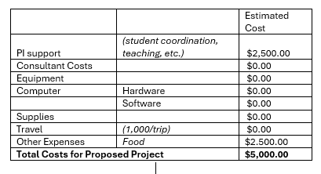
A
Challenges:
One of the main challenges of this project is coordinating the schedules of the medical students, who have tight academic and clinical commitments. This may limit their availability to participate in the educational sessions. Additionally, there is little control over when individuals with diabetes will be available at the community center, which could affect the number of participants reached and the overall impact of the program. These factors may pose difficulties in consistently delivering the educational content and achieving the desired outcomes. To incentive participation, we will offer food at these monthly events.

Slide 19
A
Initial impressions?
What elements, if any, do you think were well-executed?
What are the main weaknesses of this proposal?

Slide 20
A
Background
Background
B
Diabetes is a widespread health issue that many people struggle to manage. It can lead to serious complications if not properly controlled. Medical students have the potential to make a positive impact by educating the community about diabetes management. Through education, individuals can learn how to better manage their condition and improve their quality of life. This project aims to leverage the knowledge and enthusiasm of medical students to provide valuable diabetes education to the community
Diabetes is a chronic condition that affects millions of people worldwide, leading to significant health complications and economic burdens. Effective diabetes education is crucial for improving patient outcomes and reducing healthcare costs. This project is grounded in service learning, which emphasizes the reciprocal relationship between students and the community. By engaging in service learning, medical, physical therapy (PT), occupational therapy (OT), and nursing students can enhance their professional skills while providing valuable education to the community. Additionally, interprofessional collaboration fosters a holistic approach to diabetes care, integrating diverse perspectives and expertise. This project aims to leverage the interdisciplinary expertise of these students to provide comprehensive diabetes education in collaboration with community partners.

Slide 21
A
B
Specific Aims
Specific Aims
Educate community members about diabetes.
Improve understanding of diabetes management.
Decrease the prevalence of diabetes-related complications.
To enhance diabetes self-management skills among community members through interprofessional education.
To foster collaboration between medical, PT, OT, and nursing students, promoting a holistic approach to diabetes care.
To strengthen partnerships with local community organizations to support sustainable diabetes education initiatives.

Slide 22
B
Methods: This project will involve a series of interactive diabetes education workshops conducted at local community centers and public library branches. The workshops will be designed and delivered by an interdisciplinary team of medical, PT, OT, and nursing students, under the supervision of faculty advisors and a community health worker. Each workshop will cover key topics such as diabetes pathophysiology, nutrition, exercise, medication management, and self-monitoring of blood glucose levels.
The workshops will be held bi-weekly over a six-month period, with each session lasting approximately two hours. Participants will be recruited through the Duke Outpatient Clinic and community partners, including Lincoln, senior centers, and diabetes support groups associated with El Futuro. The goal is to engage at least 100 community members over the course of the project.
To evaluate the effectiveness of the workshops, pre- and post-intervention surveys will be administered to assess participants’ knowledge, self-efficacy, and behavioral changes related to diabetes management. Additionally, focus group discussions will be conducted to gather qualitative feedback on the program’s impact and areas for improvement. The data collected will be analyzed to inform future iterations of the program and to contribute to the broader body of research on interdisciplinary diabetes education.

Slide 23
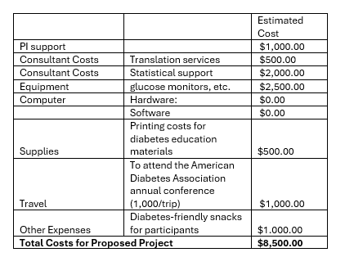
A
B
Budget
Budget

Slide 24
A
What are the main differences between the weaker and stronger proposals?
How do the strengths of the stronger proposal address the weaknesses of the weaker one?
B

Slide 25
Discussion
What key lessons can we learn from comparing stronger and weaker proposals?
How do you think these discussions will impact your approach to writing grant proposals?

Slide 26
Resources
Grants in repository: https://duke.is/aheadgrants
Office Hours
1/22, 12-1 pm (Zoom)
1/28 12-1 pm in Medical Center Library room 315

